Slide 1
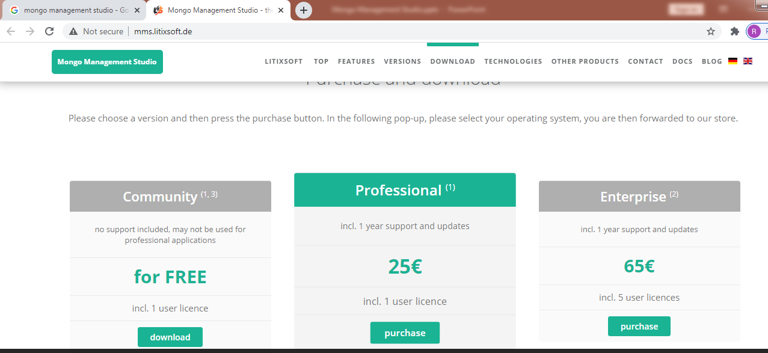
Install Mongo Management Studio On Windows
http://mms.litixsoft.de/

